Slide 1

VASIREDDY VENKATADRI INSTITUTE OF TECHNOLOGY (Autonomous) Department of Computer Science and Engineering
IV B.Tech -I Semester
Web Technologies
Unit-4
PHP Programming

Slide 2
Syllabus:
Introducing PHP: Creating PHP script, Running PHP script.
Working with variables and constants: Using variables, Using constants, Data types, Operators.
Controlling program flow: Conditional statements, Control statements.
Arrays,functions.
Working with forms and Databases such as MySQL.

Slide 3
Introducing PHP:
PHP originally stood for ―Personal Home Page, it is now said to stand for “PHP: Hypertext Preprocessor” .
PHP stands for Hypertext Preprocessor.
PHP was developed by Rasmus Lerdorf in the year 1995.
PHP is a widely-used, open source scripting language.
PHP scripts are executed on the server.
PHP is free to download and use.
PHP files can contain text, HTML, JavaScript code, and PHP code.
PHP code is executed on the server, and the result is returned to the browser as plain HTML.

Slide 4
PHP files have a default file extension of ".php".
PHP can generate dynamic page content.
PHP can create, open, read, write, and close files on the server.
PHP can collect form data.
PHP can send and receive cookies.
PHP can add, delete, modify data in your database.
PHP is naturally used for form handling and database access.
Database access has been a prime focus of PHP development , as a result it has a driver support for 15 different database systems.
PHP supports the common electronic mail protocols POP3 and IAMP.

Slide 5
What is a LAMP stack?
The LAMP stack is the foundation for Linux hosted websites is the Linux, Apache, MySQL and PHP (LAMP) software stack.
Linux based web servers consist of four software components. These components, arranged in layers supporting one another, make up the software stack. Websites and Web Applications run on top of this underlying stack.

Slide 6
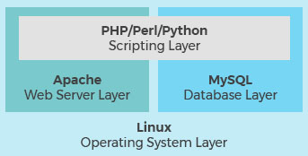

Slide 7
The Four Layers of a LAMP Stack:
The common software components that make up a traditional LAMP stack are:
Linux: The operating system (OS) makes up our first layer. Linux sets the foundation for the stack model. All other layers run on top of this layer.
Apache: The second layer consists of web server software, typically Apache Web Server. This layer resides on top of the Linux layer. Web servers are responsible for translating from web browsers to their correct website.

Slide 8
MySQL: Our third layer is where databases live. MySQL stores details that can be queried by scripting to construct a website. MySQL usually sits on top of the Linux layer alongside Apache/layer 2. In high end configurations, MySQL can be off loaded to a separate host server.
PHP: Sitting on top of them all is our fourth and final layer. The scripting layer consists of PHP and/or other similar web programming languages. Websites and Web Applications run within this layer.

Slide 9
The four traditional layers of a LAMP stack consist of free and open-source products. Linux, Apache, MySQL and PHP are the cornerstone of a free, non-proprietary LAMP stack. There are several variants of the four stack model as well. These variants use alternative software replacing one or more of the traditional components. Some examples of these alternatives are:
WAMP: Windows, Apache, MySQL & PHP
WISA: Windows, IIS, SQL & ASP.net
MAMP: MacOS, Apache, MySQL & PHP

Slide 10
Characteristics of PHP:
The main characteristics of PHP are:
PHP is web-specific and open source
Scripts are embedded into static HTML files
Fast execution of scripts
Fast access to the database tier of applications
Supported by most web servers and operating systems
Supports many standard network protocols libraries available for IMAP, NNTP, SMTP,POP3
Supports many database management systems libraries available for UNIX DBM, MySQL, Oracle
Dynamic Output any text, HTML XHTML and any other XML file

Slide 11
Advantages of PHP :
It is included inside HTML pages. This means that:
All your work can be done in the same directory, and
A single file can contain HTML and PHP code
Much easier to edit/maintain web pages.
This greatly improves tasks like
Dynamic page processing.
Checking and doing simple HTML Form based tasks.
Database connectivity

Slide 12
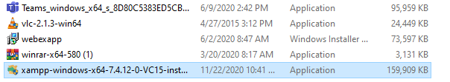

Slide 13
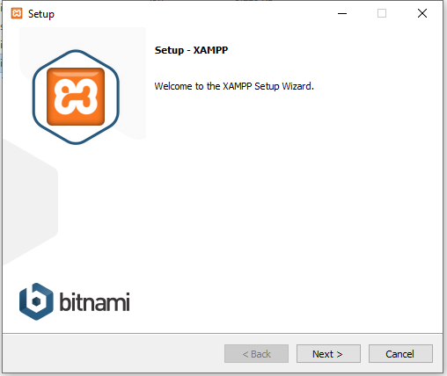
Setup Wizard :
Click on Next Button

Slide 14
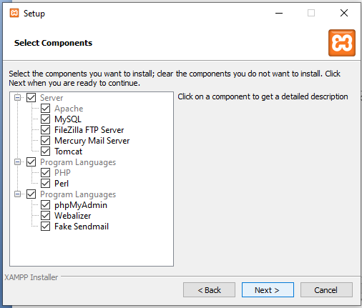
Select Components :
Click on Next Button

Slide 15
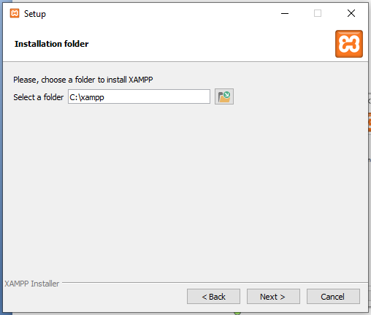
Installation folder :
Click on Next Button

Slide 16
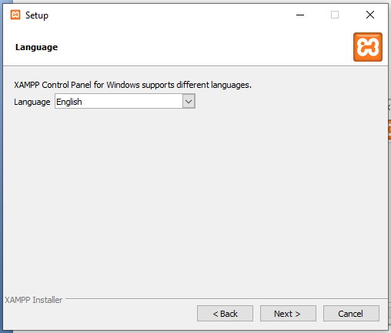
Language :
Click on Next Button

Slide 17
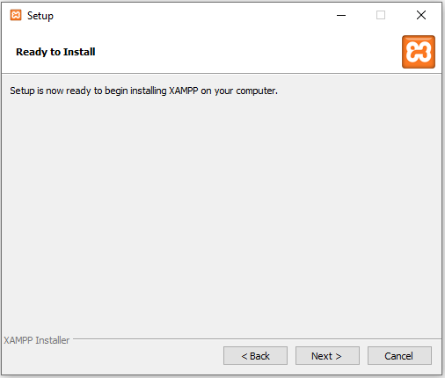
Ready to Install :
Click on Next Button

Slide 18
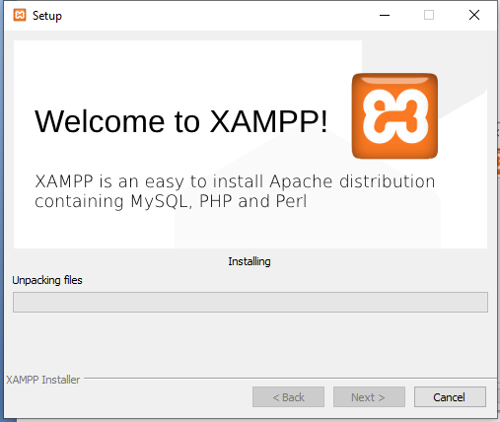
Unpacking Files :
Click on Next Button

Slide 19
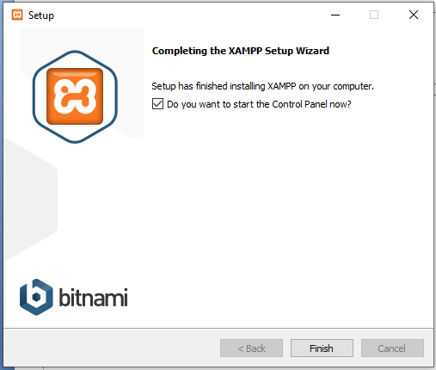
Completing the XAMPP Setup Wizard :
Click on Finish Button

Slide 20
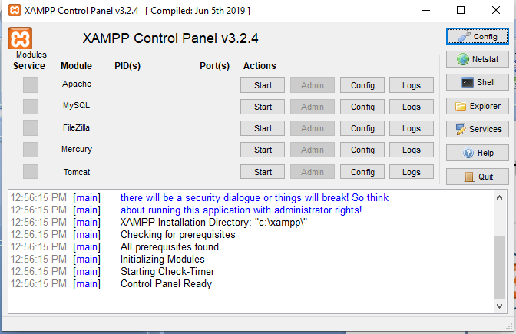
XAMPP Control Panel :

Slide 21
PHP Syntax
A PHP script is executed on the server, and the plain HTML result is sent back to the browser.
Basic PHP Syntax
A PHP script can be placed anywhere in the document.
A PHP script starts with <?php and ends with ?>:
<?php // PHP code goes here ?>
The default file extension for PHP files is ".php".
A PHP file normally contains HTML tags, and some PHP scripting code.

Slide 22
How to create and run a PHP Script
Step 1: Open any simple Text editor like notepad, gedit etc.,
Step 2: Type the PHP Code and save it with ―.php‖ extension.
Step 3: Place file in the following directory
C:\xampp\htdocs\first.php
Step 4: Start the Web server from xampp control panel
Step 5: Run files by accessing through Web browser– Must be run via web server URL

Slide 23
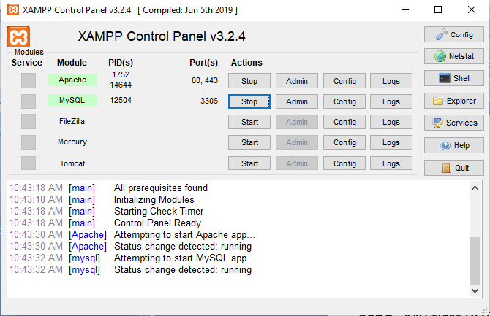

Slide 24
First.php
<!DOCTYPE html>
<html>
<body>
<?php
echo "My first PHP script!";
?>
</body>
</html>

Slide 25
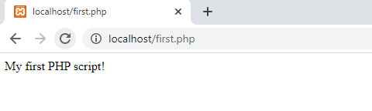

Slide 26
PHP Comments :
A comment in PHP code is a line that is not executed as a part of the program. Its only purpose is to be read by someone who is looking at the code.
PHP supports several ways of commenting:
// This is a single-line comment
# This is also a single-line comment
/* This is a multiple-lines comment block that spans over multiple lines */

Slide 27
PHP Variables
Variables are "containers" for storing information.
Creating (Declaring) PHP Variables
In PHP, a variable starts with the $ sign, followed by the name of the variable:
Example
<?php $txt = "Hello world!"; $x = 5; $y = 10.5; ?>

Slide 28
A variable can have a short name (like x and y) or a more descriptive name (age, carname, total_volume).
Rules for PHP variables:
A variable starts with the $ sign, followed by the name of the variable
A variable name must start with a letter or the underscore character
A variable name cannot start with a number
A variable name can only contain alpha-numeric characters and underscores (A-z, 0-9, and _ )
Variable names are case-sensitive ($age and $AGE are two different variables)

Slide 29
PHP is dynamically typed, it has no type declarations. There is no need to declare the type of a variable.
The type of a variable is set every time it is assigned a value.
An unsigned variable sometimes called an unbounded variable, has the value NULL, which is the only value of the NULL type.
If an unbounded variable used in an expression, NULL is forced to a value that is directed by the context of the use.
If context specifies a number, NULL is forced to 0.
If the context specifies a string, NULL is forced to be an empty string.
A variable can be tested to determine whether it currently has a value with the IsSet function, which takes the variable’s name as its parameters and returns a boolean value.

Slide 30
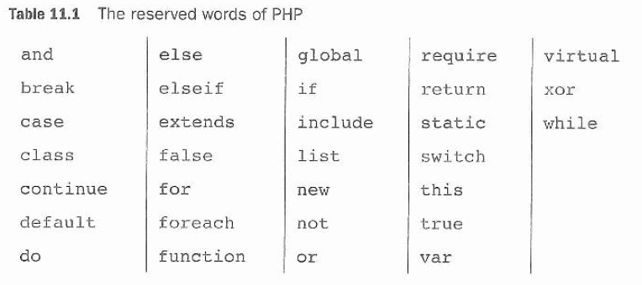
PHP Reserved Words :
Variable names in PHP are case sensitive, neither reserved words nor function names are.

Slide 31
Output Variables :
PHP, there are two basic ways to get output: echo and print.
PHP echo and print Statements
echo and print are more or less the same. They are both used to output data to the screen.
The differences are small: echo has no return value while print has a return value of 1 so it can be used in expressions.
echo can take multiple parameters (although such usage is rare) while print can take one argument. echo is marginally faster than print.

Slide 32
The PHP echo Statement
The echo statement can be used with or without parentheses: echo or echo().
Display Text
The following example shows how to output text with the echo command (notice that the text can contain HTML markup):
Example
<?php echo "<h2>PHP is Fun!</h2>"; echo "Hello world!<br>"; echo "I'm about to learn PHP!<br>"; echo "This ", "string ", "was ", "made ", "with multiple parameters."; ?>

Slide 33
The PHP print Statement
The print statement can be used with or without parentheses: print or print().
Display Text
The following example shows how to output text with the print command (notice that the text can contain HTML markup):
Example
<?php print "<h2>PHP is Fun!</h2>"; print "Hello world!<br>"; print "I'm about to learn PHP!"; ?>

Slide 34
PHP printf()
Definition and Usage
The printf() function outputs a formatted string.
The arg1, arg2, ++ parameters will be inserted at percent (%) signs in the main string. This function works "step-by-step". At the first % sign, arg1 is inserted, at the second % sign, arg2 is inserted, etc.
<?php
$number = 9;
$str = "Beijing";
printf("There are %d million bicycles in %s.",$number,$str);
?>

Slide 35
PHP Data Types :
PHP provides eight types of values, or data types. They are divided into three categories:
1. Scalar (single-value) types: integers, floating-point numbers, strings, and Booleans
2. Compound (collection) types: arrays and objects.
3. Special types: resource and NULL.

Slide 36
PHP Integer
An integer data type is a non-decimal number between -2,147,483,648 and 2,147,483,647.
Rules for integers:
An integer must have at least one digit
An integer must not have a decimal point
An integer can be either positive or negative
Integers can be specified in: decimal (base 10), hexadecimal (base 16), octal (base 8), or binary (base 2) notation

Slide 37
In the following example $x is an integer. The PHP var_dump() function returns the data type and value:
Example
<!DOCTYPE html>
<html>
<body>
<?php
$x = 5985;
var_dump($x);
?>
</body>
</html>

Slide 38
PHP Float
A float (floating point number) is a number with a decimal point or a number in exponential form.
In the following example $x is a float. The PHP var_dump() function returns the data type and value:
<!DOCTYPE html>
<html>
<body>
<?php
$x = 10.365;
var_dump($x);
?>
</body>
</html>
Output: float(10.365)

Slide 39
PHP String
A string is a sequence of characters of arbitrary length. String literals are delimited by either single or double quotes.
Variables are expanded (interpolated) within double quotes, while within single quotes they are not:
$name = "Vijay";
echo "Hi, $name\n"; // Hi, Vijay
echo 'Hi, $name'; // Hi, $name

Slide 40
Double quotes also support a variety of string escapes, listed in below Table Escape sequence Character represented
\" - Double quotes
\n Newline
\r Carriage return
\t Tab
\\ Backslash
\$ Dollar sign
\{ Left brace
\} Right brace
\[ Left bracket
\] Right bracket

Slide 41
Special Types
NULL There’s only one value of the NULL data type. That value is available through the case-insensitive keyword NULL. The NULL value represents a variable that has no value.
$alpha = "beta";
$alpha = null; // variable's value is gone $alpha = Null; // same
$alpha = NULL; // same

Slide 42
PHP Boolean
A Boolean represents two possible states: TRUE or FALSE.
$x = true; $y = false;
Booleans are often used in conditional testing.
If an integer expression is used in Boolean context it evaluates to FALSE if it is zero otherwise it is TRUE.
If a string expression is used in Boolean context, it evalutes to FALSE if it is either the empty string or the string is “0”; otherwise it is TRUE.
This implies that the string “0.0” evaluates to TRUE.

Slide 43
PHP Constants
A constant is an identifier (name) for a simple value. The value cannot be changed during the script.
A valid constant name starts with a letter or underscore (no $ sign before the constant name).
Note: Unlike variables, constants are automatically global across the entire script.
Create a PHP Constant
To create a constant, use the define() function.
Syntax
define(name, value, case-insensitive)
Parameters:
name: Specifies the name of the constant
value: Specifies the value of the constant
case-insensitive: Specifies whether the constant name should be case-insensitive. Default is false

Slide 44
PHP Operators
Operators are used to perform operations on variables and values.
PHP divides the operators in the following groups:
Arithmetic operators
Assignment operators
Comparison operators
Conditional Operator
Logical operators

Slide 45
Arithmetic Operators:
Arithmetic operators are used to perform arithmetic operations like addition, subtraction, division, etc., The following arithmetic operators supported by PHP language.
In the case of +,- and * if both operands are integers and an integer result is produced.
If either operand is a double , the operation is double and a double result is produced.
If integer division is done and the result is not an integer value the result is returned as a double.

Slide 46
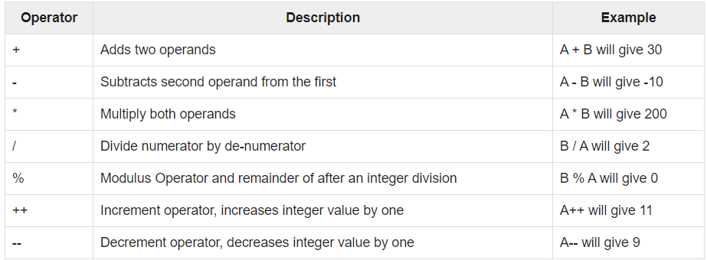
a=10 b=20

Slide 47
PHP Comparison Operators
The PHP comparison operators are used to compare two values (number or string):

Slide 48
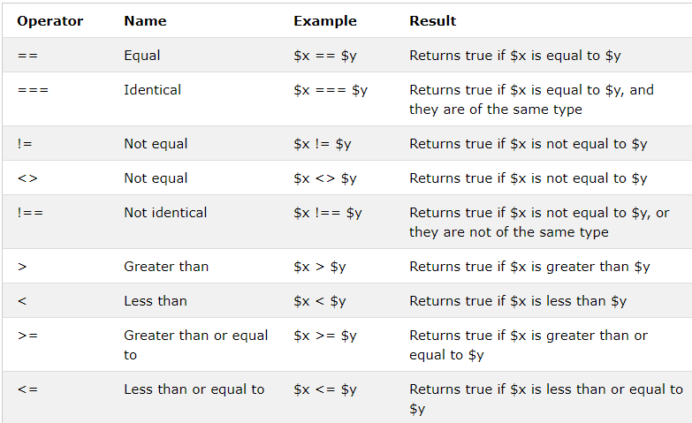

Slide 49
<!DOCTYPE html>
<html>
<body>
<?php
$x = 100;
$y = "100";
var_dump($x === $y); // returns false because types are not equal
?>
</body>
</html>

Slide 50
<!DOCTYPE html>
<html>
<body>
<?php
$x = 100;
$y = "100";
var_dump($x !== $y); // returns true because types are not equal
?>
</body>
</html>

Slide 51
Logical Operators
There are following logical operators supported by PHP language.
The PHP logical operators are used to combine conditional statements.
Assume variable A holds 10 and variable B holds 20 then:

Slide 52
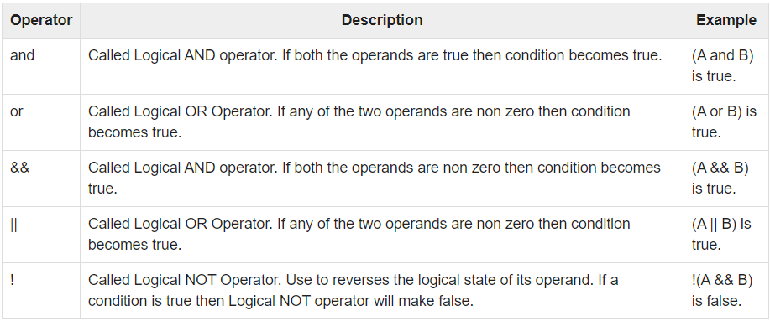

Slide 53
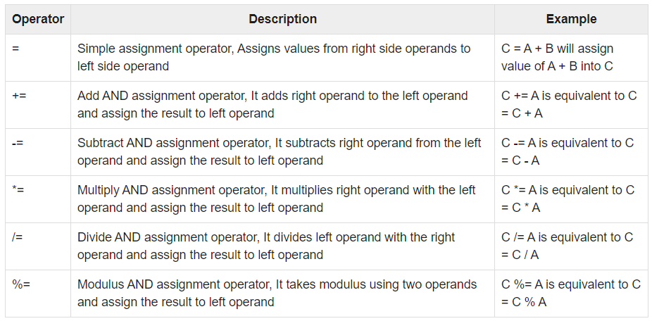
Assignment Operators : These are following assignment operators supported by PHP language

Slide 54
Conditional Operator There is one more operator called conditional operator. This first evaluates an expr1 for a true or false value and then execute one of the two given expressions depending upon the result of the evaluation. The conditional operator has this syntax:
$result = expr1 ? expr2 : expr3;
Returns the value of $x. The value of $x is expr2 if expr1 = TRUE. The value of $x is expr3 if expr1 = FALSE.

Slide 55
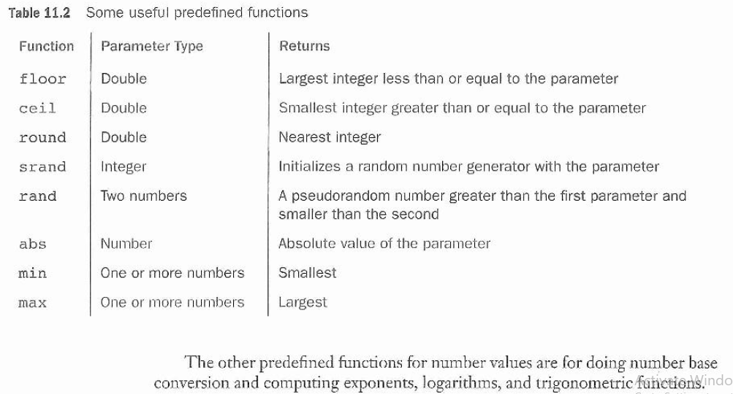

Slide 56
Operator precedence determines the grouping of terms in an expression. This affects how an expression is evaluated. Certain operators have higher precedence than others; for example, the multiplication operator has higher precedence than the addition operator −
For example x = 7 + 3 * 2; Here x is assigned 13, not 20 because operator * has higher precedence than + so it first get multiplied with 3*2 and then adds into 7.

Slide 57
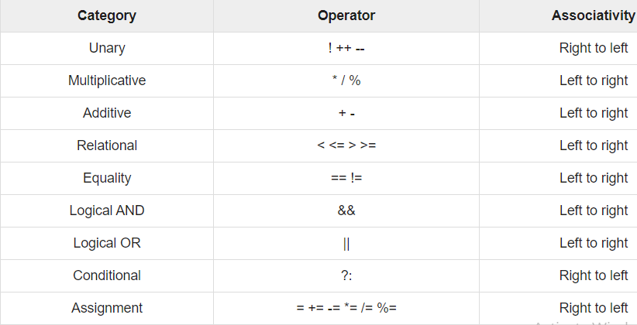

Slide 58
Controlling program flow: Conditional statements
The if, elseif ...else and switch statements are used to take decisions based on the different condition. You can use conditional statements in your code to make your decisions. PHP supports following three decision making statements:
1. if...else statement - Use this statement if you want to execute a set of code when a condition is true and another if the condition is false.
2. elseif statement - is used with the if...else statement to execute a set of code if one of several condition are true
3. switch statement - is used if you want to select one of many blocks of code to be executed, use the Switch statement. The switch statement is used to avoid long blocks of if...elseif...else code.

Slide 59
In PHP we have the following conditional statements:
if statement - executes some code if one condition is true
if...else statement - executes some code if a condition is true and another code if that condition is false
if...elseif...else statement - executes different codes for more than two conditions
switch statement - selects one of many blocks of code to be executed

Slide 60
PHP - The if Statement
The if statement executes some code if one condition is true.
Syntax
if (condition) { code to be executed if condition is true; }
<!DOCTYPE html>
<html>
<body>
<?php
$t = date("H");
if ($t < "20") {
echo "Have a good day!";
}
?>
</body>
</html>

Slide 61
The If...Else Statement
If you want to execute some code if a condition is true and another code if a condition is false, use the if....else statement.
Syntax
if (condition)
code to be executed if condition is true;
else
code to be executed if condition is false;
If ($day == “saturday” || $day==“sunday”)
$today=“weekend”;
Else
$today=“weekday”

Slide 62
The If...else...if Statement
If you want to execute some code if one of several conditions are true use the elseif statement
Syntax
if (condition)
code to be executed if condition is true;
elseif (condition)
code to be executed if condition is true;
else
code to be executed if condition is false;

Slide 63
The Switch Statement
If you want to select one of many blocks of code to be executed, use the Switch statement. The switch statement is used to avoid long blocks of if..elseif..else code.
Syntax
switch (expression)
{
case label1:
code to be executed if expression = label1;
break;
case label2:
code to be executed if expression = label2;
break;
default:
code to be executed if expression is different
from both label1 and label2;
}

Slide 64
PHP Loops
Loops in PHP are used to execute the same block of code a specified number of times. PHP supports following four loop types.
1. for - loops through a block of code a specified number of times.
2. while - loops through a block of code if and as long as a specified condition is true.
3. do...while - loops through a block of code once, and then repeats the loop as long as the condition is true.
4. foreach - loops through a block of code for each element in an array.

Slide 65
The PHP while Loop
The while loop executes a block of code as long as the specified condition is true.
Syntax
while (condition is true) { code to be executed; }
Examples
The example below displays the numbers from 1 to 5:
Example
<?php $x = 1; while($x <= 5) { echo "The number is: $x <br>"; $x++; } ?>

Slide 66
The for loop statement
The for statement is used when you know the exact number of times to execute a statement or a block of statements.
Syntax
for (initialization; condition; increment/decrement)
{
Code to be executed;
}
The initializer is used to set the start value for the counter of the number of loop iterations.
Example
The following example makes ten iterations and prints 1 to 10 numbers:

Slide 67
$x = 1; - Initialize the loop counter ($x), and set the start value to 1
$x <= 5 - Continue the loop as long as $x is less than or equal to 5
$x++; - Increase the loop counter value by 1 for each iteration

Slide 68
The PHP do...while Loop
The do...while loop will always execute the block of code once, it will then check the condition, and repeat the loop while the specified condition is true.
Syntax
do { code to be executed; } while (condition is true);

Slide 69
The PHP for Loop
The for loop is used when you know in advance how many times the script should run.
Syntax
for (init counter; test counter; increment counter) { code to be executed for each iteration; }
Parameters:
init counter: Initialize the loop counter value
test counter: Evaluated for each loop iteration. If it evaluates to TRUE, the loop continues. If it evaluates to FALSE, the loop ends.
increment counter: Increases the loop counter value

Slide 70
<html>
<body>
<?php
for( $i=1; $i<=10; $i++ )
{
echo ("$i".” “ );
}
?>
</body>
</html>

Slide 71
The PHP foreach Loop
The foreach loop works only on arrays, and is used to loop through each key/value pair in an array.
Syntax
foreach ($array as $value) { code to be executed; }
For every loop iteration, the value of the current array element is assigned to $value and the array pointer is moved by one, until it reaches the last array element.

Slide 72
The break statement
The PHP break keyword is used to terminate the execution of a loop prematurely. The break statement is situated inside the statement block.
It gives you full control and whenever you want to exit from the loop you can come out. After coming out of a loop immediate statement to the loop will be executed.

Slide 73
<html>
<body>
<?php
$i = 0;
while( $i < 10)
{
$i++;
if( $i == 3 )break;
}
echo ("Loop stopped at i = $i" );
?>
</body>
</html>

Slide 74
The continue statement
The PHP continue keyword is used to halt the current iteration of a loop and place the loop in next iteration. But it does not terminate the loop.
Just like the break statement the continue statement is situated inside the statement block containing the code that the loop executes, preceded by a conditional test. For the pass encountering continue statement, rest of the loop code is skipped and next pass starts.

Slide 75
<html>
<body>
<?php
$array = array( 1, 2, 3, 4, 5);
foreach( $array as $value )
{
if( $value == 3 )
continue;
echo "Value is $value <br/>";
}
?>
</body>
</html>

Slide 76
PHP Arrays
An array is a data structure that stores one or more similar type of values in a single value. There are three different kind of arrays and each array value is accessed using an ID which is called array index.
1. Numeric array - An array with a numeric index. Values are stored and accessed in linear fashion
2. Associative array - An array with strings as index. This stores element values in association with key values rather than in a strict linear index order.
3. Multidimensional array - An array containing one or more arrays and values are accessed using multiple indices

Slide 77
Numeric Array or Indexed Array
These arrays can store numbers, strings and any object but their index will be represented by numbers. By default array index starts from zero. Example Following is the example showing how to create and access numeric arrays. Here we have used array() function to create array.
There are two ways to create indexed arrays:
The index can be assigned automatically (index always starts at 0), like this:
$cars = array("Volvo", "BMW", "Toyota");
or the index can be assigned manually:
$cars[0] = "Volvo"; $cars[1] = "BMW"; $cars[2] = "Toyota";

Slide 78
<!DOCTYPE html>
<html>
<body>
<?php
$cars = array("Volvo", "BMW", "Toyota");
$arrlength = count($cars);
for($x = 0; $x < $arrlength; $x++) {
echo $cars[$x];
echo "<br>";
}
?>
</body>
</html>

Slide 79
<html>
<body>
<?php
$numbers = array(1,2,3,4,5); /* First method to create array. */ foreach($numbers as $value)
echo "Value is $value <br />";
$numbers[0] = "one"; /* Second method to create array. */ $numbers[1] = "two";
$numbers[2] = "three";
$numbers[3] = "four";
$numbers[4] = "five";
foreach( $numbers as $value ) echo "Value is $value <br />";
?>
</body> </html>

Slide 80
Associative Arrays
The associative arrays are very similar to numeric arrays in term of functionality but they are different in terms of their index. Associative array will have their index as string so that you can establish a strong association between key and values.
There are two ways to create an associative array:
$age = array("Peter"=>"35", "Ben"=>"37", "Joe"=>"43");
or:
$age['Peter'] = "35"; $age['Ben'] = "37"; $age['Joe'] = "43";
The named keys can then be used in a script

Slide 81
<!DOCTYPE html>
<html>
<body>
<?php
$age = array("Peter"=>"35", "Ben"=>"37", "Joe"=>"43");
echo "Peter is " . $age['Peter'] . " years old.";
?>
</body>
</html>

Slide 82
Multidimensional Arrays
A multidimensional array is an array containing one or more arrays.
PHP supports multidimensional arrays that are two, three, four, five, or more levels deep. However, arrays more than three levels deep are hard to manage for most people.
A multi-dimensional array each element in the main array can also be an array. And each element in the sub-array can be an array, and so on. Values in the multi-dimensional array are accessed using multiple index.
A two-dimensional array is an array of arrays (a three-dimensional array is an array of arrays of arrays).

Slide 83
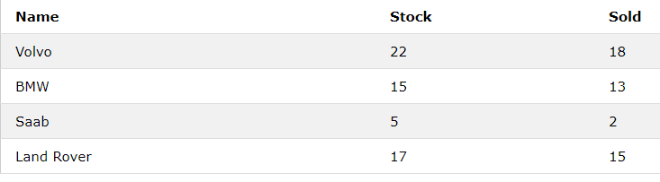
We can store the data from the table above in a two-dimensional array, like this:
$cars = array ( array("Volvo",22,18), array("BMW",15,13), array("Saab",5,2), array("Land Rover",17,15) );
Now the two-dimensional $cars array contains four arrays, and it has two indices: row and column.
To get access to the elements of the $cars array we must point to the two indices (row and column)

Slide 84
<!DOCTYPE html>
<html>
<body>
<?php
$cars = array (
array("Volvo",22,18),
array("BMW",15,13),
array("Saab",5,2),
array("Land Rover",17,15)
);
for ($row = 0; $row < 4; $row++) {
echo "<p><b>Row number $row</b></p>";
echo "<ul>";
for ($col = 0; $col < 3; $col++) {
echo "<li>".$cars[$row][$col]."</li>";
}
echo "</ul>";
}
?>
</body>
</html>

Slide 85
PHP Sorting Arrays
The elements in an array can be sorted in alphabetical or numerical order, descending or ascending.
PHP - Sort Functions For Arrays
In this chapter, we will go through the following PHP array sort functions:
sort() - sort arrays in ascending order
rsort() - sort arrays in descending order
asort() - sort associative arrays in ascending order, according to the value
ksort() - sort associative arrays in ascending order, according to the key
arsort() - sort associative arrays in descending order, according to the value
krsort() - sort associative arrays in descending order, according to the key

Slide 86
Sort Array in Ascending Order - sort()
The following example sorts the elements of the $cars array in ascending alphabetical order:
<!DOCTYPE html>
<html>
<body>
<?php
$cars = array("Volvo", "BMW", "Toyota");
sort($cars);
$clength = count($cars);
for($x = 0; $x < $clength; $x++) {
echo $cars[$x];
echo "<br>";
}
?>
</body>
</html>

Slide 87
The following example sorts the elements of the $numbers array in ascending numerical order:
<!DOCTYPE html>
<html>
<body>
<?php
$numbers = array(4, 6, 2, 22, 11);
sort($numbers);
$arrlength = count($numbers);
for($x = 0; $x < $arrlength; $x++) {
echo $numbers[$x];
echo "<br>";
}
?>
</body>
</html>

Slide 88
Sort Array in Descending Order - rsort()
The following example sorts the elements of the $cars array in descending alphabetical order
<!DOCTYPE html>
<html>
<body>
<?php
$cars = array("Volvo", "BMW", "Toyota");
rsort($cars);
$clength = count($cars);
for($x = 0; $x < $clength; $x++) {
echo $cars[$x];
echo "<br>";
}
?>
</body>
</html>

Slide 89
The following example sorts the elements of the $numbers array in descending numerical order<!DOCTYPE html>
<html>
<body>
<?php
$numbers = array(4, 6, 2, 22, 11);
rsort($numbers);
$arrlength = count($numbers);
for($x = 0; $x < $arrlength; $x++) {
echo $numbers[$x];
echo "<br>";
}
?>
</body>
</html>

Slide 90
Sort Array (Ascending Order), According to Value - asort()
The following example sorts an associative array in ascending order, according to the value:
<!DOCTYPE html>
<html>
<body>
<?php
$age = array("Peter"=>"35", "Ben"=>"37", "Joe"=>"43");
asort($age);
foreach($age as $x => $x_value) {
echo "Key=" . $x . ", Value=" . $x_value;
echo "<br>";
}
?>
</body>
</html>

Slide 91
Sort Array (Ascending Order), According to Key - ksort()
The following example sorts an associative array in ascending order, according to the key:
<!DOCTYPE html>
<html>
<body>
<?php
$age = array("Peter"=>"35", "Ben"=>"37", "Joe"=>"43");
ksort($age);
foreach($age as $x => $x_value) {
echo "Key=" . $x . ", Value=" . $x_value;
echo "<br>";
}
?>
</body>
</html>

Slide 92
Sort Array (Descending Order), According to Value - arsort()
The following example sorts an associative array in descending order, according to the value:
<!DOCTYPE html>
<html>
<body>
<?php
$age = array("Peter"=>"35", "Ben"=>"37", "Joe"=>"43");
arsort($age);
foreach($age as $x => $x_value) {
echo "Key=" . $x . ", Value=" . $x_value;
echo "<br>";
}
?>
</body>
</html>

Slide 93
Sort Array (Descending Order), According to Key - krsort()
The following example sorts an associative array in descending order, according to the key:
<!DOCTYPE html>
<html>
<body>
<?php
$age = array("Peter"=>"35", "Ben"=>"37", "Joe"=>"43");
krsort($age);
foreach($age as $x => $x_value) {
echo "Key=" . $x . ", Value=" . $x_value;
echo "<br>";
}
?>
</body>
</html>

Slide 94
PHP Strings
PHP String Functions
strlen() - Return the Length of a String
str_word_count() - Count Words in a String
strrev() - Reverse a String
strpos() - Search For a Text Within a String.The PHP strpos() function searches for a specific text within a string. If a match is found, the function returns the character position of the first match. If no match is found, it will return FALSE.
str_replace() - Replace Text Within a String.The PHP str_replace() function replaces some characters with some other characters in a string.

Slide 95
PHP User Defined Functions
Besides the built-in PHP functions, it is possible to create your own functions.
A function is a block of statements that can be used repeatedly in a program.
A function will not execute automatically when a page loads.
A function will be executed by a call to the function.
PHP functions are similar to other programming languages. A function is a piece of code which takes one more input in the form of parameter and does some processing and returns a value.

Slide 96
Create a User Defined Function in PHP
A user-defined function declaration starts with the word function:
Syntax
function functionName() { code to be executed; }
A function name must start with a letter or an underscore.
<!DOCTYPE html>
<html>
<body>
<?php
function writeMsg() {
echo "Hello world!";
}
writeMsg();
?>
</body>
</html>

Slide 97
Its very easy to create your own PHP function. Suppose you want to create a PHP function which will simply write a simple message on your browser when you will call it. Following example creates a function called writeMessage() and then calls it just after creating it.
Note that while creating a function its name should start with keyword function and all the PHP code should be put inside { and } braces as shown in the following example below:

Slide 98
PHP Functions with Parameters (Passing Arguments by Value)
PHP gives you option to pass your parameters inside a function. You can pass as many as parameters you like, just separate them with a comma. These parameters work like variables inside your function. Following example takes two integer parameters and add them together and then print them.

Slide 99
<html>
<head>
<title>Writing PHP Function with Parameters</title>
</head>
<body>
<?php
function add($num1, $num2)
{
$sum = $num1 + $num2;
echo "Sum of the two numbers is : $sum";
}
add(10, 20);
?>
</body>
</html>

Slide 100
PHP Functions - Returning values
To let a function return a value, use the return statement:
PHP Return Type Declarations
PHP 7 also supports Type Declarations for the return statement. Like with the type declaration for function arguments, by enabling the strict requirement, it will throw a "Fatal Error" on a type mismatch.
To declare a type for the function return, add a colon ( : ) and the type right before the opening curly ( { )bracket when declaring the function.

Slide 101
<?php declare(strict_types=1); // strict requirement ?>
<!DOCTYPE html>
<html>
<body>
<?php
function sum(int $x, int $y) {
$z = $x + $y;
return $z;
}
echo "5 + 10 = " . sum(5,10) . "<br>";
echo "7 + 13 = " . sum(7,13) . "<br>";
echo "2 + 4 = " . sum(2,4);
?>
</body>
</html>

Slide 102
<?php declare(strict_types=1); // strict requirement
function addNumbers(float $a, float $b) : float {
return $a + $b;
}
echo addNumbers(1.2, 5.3);
?>

Slide 103
Passing Arguments by Reference
In PHP, arguments are usually passed by value, which means that a copy of the value is used in the function and the variable that was passed into the function cannot be changed.
When a function argument is passed by reference, changes to the argument also change the variable that was passed in. To turn a function argument into a reference, the & operator is used:

Slide 104
<!DOCTYPE html>
<html>
<body>
<?php
function add_five(&$value) {
$value += 5;
}
$num = 2;
add_five($num);
echo $num;
?>
</body>
</html>

Slide 105
PHP is a Loosely Typed Language
In the example above, notice that we did not have to tell PHP which data type the variable is.
PHP automatically associates a data type to the variable, depending on its value. Since the data types are not set in a strict sense, you can do things like adding a string to an integer without causing an error.
In PHP 7, type declarations were added. This gives us an option to specify the expected data type when declaring a function, and by adding the strict declaration, it will throw a "Fatal Error" if the data type mismatches.

Slide 106
<?php
function addNumbers(int $a, int $b) {
return $a + $b;
}
echo addNumbers(5, "5 days");
// since strict is NOT enabled "5 days" is changed to int(5), and it will return 10
?>

Slide 107
To specify strict we need to set declare(strict_types=1);. This must be on the very first line of the PHP file.
In the following example we try to send both a number and a string to the function, but here we have added the strict declaration:
Example
<?php declare(strict_types=1); // strict requirement function addNumbers(int $a, int $b) { return $a + $b; } echo addNumbers(5, "5 days"); // since strict is enabled and "5 days" is not an integer, an error will be thrown ?>

Slide 108
PHP Global Variables - Superglobals
Superglobals were introduced in PHP 4.1.0, and are built-in variables that are always available in all scopes.
PHP Global Variables - Superglobals
Some predefined variables in PHP are "superglobals", which means that they are always accessible, regardless of scope - and you can access them from any function, class or file without having to do anything special.
The PHP superglobal variables are:
$GLOBALS
$_SERVER
$_REQUEST
$_POST
$_GET
$_FILES
$_ENV
$_COOKIE
$_SESSION

Slide 109
PHP $GLOBALS
$GLOBALS is a PHP super global variable which is used to access global variables from anywhere in the PHP script (also from within functions or methods).
PHP stores all global variables in an array called $GLOBALS[index]. The index holds the name of the variable.
<?php $x = 75; $y = 25; function addition() { $GLOBALS['z'] = $GLOBALS['x'] + $GLOBALS['y']; } addition(); echo $z; ?>
In the example above, since z is a variable present within the $GLOBALS array, it is also accessible from outside the function!

Slide 110
PHP $_SERVER
$_SERVER is a PHP super global variable which holds information about headers, paths, and script locations.
The example below shows how to use some of the elements in $_SERVER:
Example
<?php echo $_SERVER['PHP_SELF']; echo "<br>"; echo $_SERVER['SERVER_NAME']; echo "<br>"; echo $_SERVER['HTTP_HOST']; echo "<br>"; echo $_SERVER['HTTP_REFERER']; echo "<br>"; echo $_SERVER['HTTP_USER_AGENT']; echo "<br>"; echo $_SERVER['SCRIPT_NAME']; ?>

Slide 111
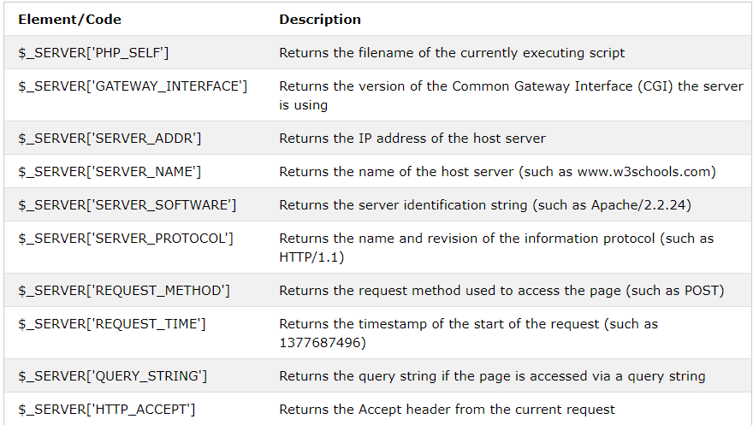

Slide 112
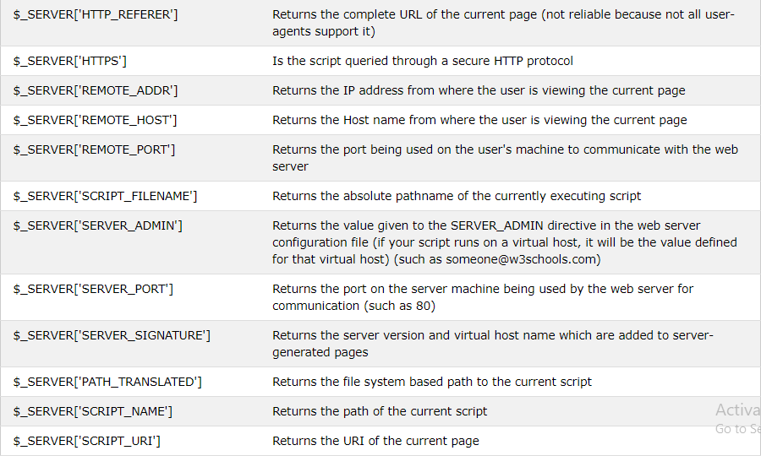

Slide 113
PHP $_REQUEST
PHP $_REQUEST is a PHP super global variable which is used to collect data after submitting an HTML form.
a form with an input field and a submit button. When a user submits the data by clicking on "Submit", the form data is sent to the file specified in the action attribute of the <form> tag.
In this example, we point to this file itself for processing form data. If you wish to use another PHP file to process form data, replace that with the filename of your choice. Then, we can use the super global variable $_REQUEST to collect the value of the input field:

Slide 114
PHP $_POST
PHP $_POST is a PHP super global variable which is used to collect form data after submitting an HTML form with method="post". $_POST is also widely used to pass variables.
The example below shows a form with an input field and a submit button. When a user submits the data by clicking on "Submit", the form data is sent to the file specified in the action attribute of the <form> tag.
In this example, we point to the file itself for processing form data. If you wish to use another PHP file to process form data, replace that with the filename of your choice. Then, we can use the super global variable $_POST to collect the value of the input field:

Slide 115
PHP $_GET
PHP $_GET is a PHP super global variable which is used to collect form data after submitting an HTML form with method="get".
$_GET can also collect data sent in the URL.

Slide 116
PHP - File Inclusion
The content of a PHP file into another PHP file before the server executes it. There are two PHP functions which can be used to included one PHP file into another PHP file.
The include() Function
The require() Function
This is a strong point of PHP which helps in creating functions, headers, footers, or elements that can be reused on multiple pages. This will help developers to make it easy to change the layout of complete website with minimal effort. If there is any change required then instead of changing thousand of files just change included file.

Slide 117
The include() Function
The include() function takes all the text in a specified file and copies it into the file that uses the include function. If there is any problem in loading a file then the include() function generates a warning but the script will continue execution.
Assume you want to create a common menu for your website. Then create a file menu.php with the following content.

Slide 118
<html>
<head><title>menu page</title>
<body bgcolor="pink">
<table border="2" width="100%" bgcolor="pink">
<tr>
<th><a href="home.html" target="c">HOME</a></th>
<th><a href="login.html" target="c">LOGIN</a></th>
<th><a href="reg.html" target="c">REGISTRATION</a></th>
<th><a href="cat.html" target="c">CATALOGUE</a></th>
<th><a href="cart.html" target="c">CART</a></th>
</tr>
</table>
</body>
</html>

Slide 119
<html>
<body>
<?php include("menu.php"); ?>
<p>This is an example to show how to include PHP file!</p>
</body>
</html>

Slide 120
The require() Function
The require() function takes all the text in a specified file and copies it into the file that uses the include function. If there is any problem in loading a file then the require() function generates a fatal error and halt the execution of the script.
So there is no difference in require() and include() except they handle error conditions. It is recommended to use the require() function instead of include(), because scripts should not continue executing if files are missing or misnamed.

Slide 121
List out the two modes of PHP processor
The HTML part of the program is copied unchanged to the client browser
The PHP code is interpreted where it is encountered in the document.
The last two statements may need a little more explanation. The .php file extension alerts the Web server program to hand the file off to the PHP processor.
The PHP processor has two modes, copy and interpret. The processor starts off in copy mode; text from the file, presumably HTML, is copied to the network connection and sent to the client browser.
When a <?php processing instruction is encountered the processor switches to interpret mode. The PHP statements are interpreted, and their output, if any, is sent to the browser. The processor remains in interpret mode until a ?> is encountered, which switches it back to copy mode.

Slide 122
PHP Types of Errors
Error is the fault or mistake in a program. It can be several types. Error can occur due to wrong syntax or wrong logic. It is a type of mistakes or condition of having incorrect knowledge of the code.
There are various types of errors in PHP but it contains basically four main type of errors.
Parse error or Syntax Error: It is the type of error done by the programmer in the source code of the program. The syntax error is caught by the compiler. After fixing the syntax error the compiler compile the code and execute it.
Parse errors can be caused dues to unclosed quotes, missing or Extra parentheses, Unclosed braces, Missing semicolon etc

Slide 123
Example:
<?php
$x = "geeks";
y = "Computer science";
echo $x;
echo $y;
?>
Error:
PHP Parse error: syntax error, unexpected '=' on line 3.
Explanation: In above program, $ sign is missing in line 3 so it gives an error message.

Slide 124
Fatal Error: It is the type of error where PHP compiler understand the PHP code but it recognizes an undeclared function. This means that function is called without the definition of function. Example:
<?php
function add($x, $y)
{
$sum = $x + $y;
echo "sum = " . $sum;
}
$x = 0;
$y = 20;
add($x, $y);
diff($x, $y);
?>
Error:
PHP Fatal error: Uncaught Error: Call to undefined function diff() on line 12
Explanation : In line 12, function is called but the definition of function is not available. So it gives error.

Slide 125
Warning Errors : The main reason of warning errors are including a missing file. This means that the PHP function call the missing file. Example:
<?php
$x = "GeeksforGeeks";
include ("gfg.php");
echo $x . "Computer science portal";
?>
Error:
PHP Warning: include(gfg.php): failed to open stream: No such file or directory in /home/aed0ed3b35fece41022f332aba5c9b45.php on line 5PHP Warning: include(): Failed opening 'gfg.php' for inclusion (include_path='.:/usr/share/php') on line 5 Explanation: This program call an undefined file gfg.php which are not available. So it produces error.

Slide 126
Notice Error: It is similar to warning error. It means that the program contains something wrong but it allows the execution of script. Example:
<?php
$x = “vvit";
echo $x;
echo $cse;
?>
Error:
PHP Notice: Undefined variable: geeks on line 5 Output:
vvit
Explanation: This program use undeclared variable $cse so it gives error message.

Slide 127
PHP error constants and their description :
E_ERROR : A fatal error that causes script termination
E_WARNING : Run-time warning that does not cause script termination
E_PARSE : Compile time parse error.
E_NOTICE : Run time notice caused due to error in code
E_CORE_ERROR : Fatal errors that occur during PHP’s initial startup (installation)
E_CORE_WARNING : Warnings that occur during PHP’s initial startup
E_COMPILE_ERROR : Fatal compile-time errors indication problem with script.
E_USER_ERROR : User-generated error message.
E_USER_WARNING : User-generated warning message.
E_USER_NOTICE : User-generated notice message.
E_STRICT : Run-time notices.
E_RECOVERABLE_ERROR : Catchable fatal error indicating a dangerous error
E_DEPRECATED : Run-time notices.

Slide 128
PHP Cookies
What is a Cookie?
A cookie is often used to identify a user.
A cookie is a small file that the server embeds on the user's computer. Each time the same computer requests a page with a browser, it will send the cookie too.
With PHP, you can both create and retrieve cookie values.
Create Cookies With PHP
A cookie is created with the setcookie() function.
Syntax
setcookie(name, value, expire, path, domain, secure, httponly);
Only the name parameter is required. All other parameters are optional.

Slide 129
PHP Create/Retrieve a Cookie
The following example creates a cookie named "user" with the value "John Doe". The cookie will expire after 30 days (86400 * 30). The "/" means that the cookie is available in entire website (otherwise, select the directory you prefer).
We then retrieve the value of the cookie "user" (using the global variable $_COOKIE). We also use the isset() function to find out if the cookie is set:
Example
<?php $cookie_name = "user"; $cookie_value = "John Doe"; setcookie($cookie_name, $cookie_value, time() + (86400 * 30), "/"); // 86400 = 1 day ?> <html> <body> <?php if(!isset($_COOKIE[$cookie_name])) { echo "Cookie named '" . $cookie_name . "' is not set!"; } else { echo "Cookie '" . $cookie_name . "' is set!<br>"; echo "Value is: " . $_COOKIE[$cookie_name]; } ?> </body> </html>
Note: The setcookie() function must appear BEFORE the <html> tag.
Note: The value of the cookie is automatically URLencoded when sending the cookie, and automatically decoded when received (to prevent URLencoding, use setrawcookie() instead).

Slide 130
Modify a Cookie Value
To modify a cookie, just set (again) the cookie using the setcookie() function:
Example
<?php $cookie_name = "user"; $cookie_value = "Alex Porter"; setcookie($cookie_name, $cookie_value, time() + (86400 * 30), "/"); ?> <html> <body> <?php if(!isset($_COOKIE[$cookie_name])) { echo "Cookie named '" . $cookie_name . "' is not set!"; } else { echo "Cookie '" . $cookie_name . "' is set!<br>"; echo "Value is: " . $_COOKIE[$cookie_name]; } ?> </body> </html>

Slide 131
Delete a Cookie
To delete a cookie, use the setcookie() function with an expiration date in the past:
Example
<?php // set the expiration date to one hour ago setcookie("user", "", time() - 3600); ?> <html> <body> <?php echo "Cookie 'user' is deleted."; ?> </body> </html>

Slide 132
Check if Cookies are Enabled
The following example creates a small script that checks whether cookies are enabled. First, try to create a test cookie with the setcookie() function, then count the $_COOKIE array variable:
Example
<?php setcookie("test_cookie", "test", time() + 3600, '/'); ?> <html> <body> <?php if(count($_COOKIE) > 0) { echo "Cookies are enabled."; } else { echo "Cookies are disabled."; } ?> </body> </html>

Slide 133
PHP Sessions
A session is a way to store information (in variables) to be used across multiple pages.
Unlike a cookie, the information is not stored on the users computer.
What is a PHP Session?
When you work with an application, you open it, do some changes, and then you close it. This is much like a Session. The computer knows who you are. It knows when you start the application and when you end. But on the internet there is one problem: the web server does not know who you are or what you do, because the HTTP address doesn't maintain state.
Session variables solve this problem by storing user information to be used across multiple pages (e.g. username, favorite color, etc). By default, session variables last until the user closes the browser.
So; Session variables hold information about one single user, and are available to all pages in one application.

Slide 134
Start a PHP Session
A session is started with the session_start() function.
Session variables are set with the PHP global variable: $_SESSION.
Now, let's create a new page called "demo_session1.php". In this page, we start a new PHP session and set some session variables:
Example
<?php // Start the session session_start(); ?> <!DOCTYPE html> <html> <body> <?php // Set session variables $_SESSION["favcolor"] = "green"; $_SESSION["favanimal"] = "cat"; echo "Session variables are set."; ?> </body> </html>
Note: The session_start() function must be the very first thing in your document.

Slide 135
Get PHP Session Variable Values
Next, we create another page called "demo_session2.php". From this page, we will access the session information we set on the first page ("demo_session1.php").
Notice that session variables are not passed individually to each new page, instead they are retrieved from the session we open at the beginning of each page (session_start()).
Also notice that all session variable values are stored in the global $_SESSION variable:
Example
<?php session_start(); ?> <!DOCTYPE html> <html> <body> <?php // Echo session variables that were set on previous page echo "Favorite color is " . $_SESSION["favcolor"] . ".<br>"; echo "Favorite animal is " . $_SESSION["favanimal"] . "."; ?> </body> </html>

Slide 136
Modify a PHP Session Variable
To change a session variable, just overwrite it:
Example
<?php session_start(); ?> <!DOCTYPE html> <html> <body> <?php // to change a session variable, just overwrite it $_SESSION["favcolor"] = "yellow"; print_r($_SESSION); ?> </body> </html>

Slide 137
Destroy a PHP Session
To remove all global session variables and destroy the session, use session_unset() and session_destroy():
Example
<?php session_start(); ?> <!DOCTYPE html> <html> <body> <?php // remove all session variables session_unset(); // destroy the session session_destroy(); ?> </body> </html>

Slide 138
Open a Connection to MySQL
Before we can access data in the MySQL database, we need to be able to connect to the server.
PHP communication with Mysql can be divided into 5 steps like
1) Connecting to the Database
2) Selecting to the Database
3) Query the Database
4) Fetching the Records or getting the records from Query or Query String.
5) Close the Connection.

Slide 139
1) Connecting to the Database
We can connect in two ways:
A) Normal Connection B) Persistence Connection
Normal Connection: Will be active for the Single Program, A Normal Connection can be Closed by Using mysql_close();
mysql_connect('hostname','username','password');
Persistance Connection: A Persistance Connection is a Permanent Connection Once establish it cannot be closed.
mysql_pconnect('hostname','username','password');

Slide 140
Opening Database Connection
PHP provides mysql_connect function to open a database connection. This function takes five parameters and returns a MySQL link identifier on success, or FALSE on failure.
Syntax
connection mysql_connect(server,user,passwd,new_link,client_flag);

Slide 141
1server
Optional − The host name running database server. If not specified then default value is localhost:3306.
2user
Optional − The username accessing the database. If not specified then default is the name of the user that owns the server process.
3passwd
Optional − The password of the user accessing the database. If not specified then default is an empty password.
4new_link
Optional − If a second call is made to mysql_connect() with the same arguments, no new connection will be established; instead, the identifier of the already opened connection will be returned.
5client_flags
Optional − A combination of the following constants −
MYSQL_CLIENT_SSL − Use SSL encryption
MYSQL_CLIENT_COMPRESS − Use compression protocol
MYSQL_CLIENT_IGNORE_SPACE − Allow space after function names
MYSQL_CLIENT_INTERACTIVE − Allow interactive timeout seconds of inactivity before closing the connection
You can specify server, user, passwd in php.ini file instead of using them again and again in your every PHP scripts. Check php.ini file configuration.

Slide 142
Creating a Database
To create and delete a database you should have admin privilege. Its very easy to create a new MySQL database. PHP uses mysql_query function to create a MySQL database. This function takes two parameters and returns TRUE on success or FALSE on failure.
Syntax
bool mysql_query( sql, connection );
1sql
Required - SQL query to create a database
2connection
Optional - if not specified then last opend connection by mysql_connect will be used.

Slide 143
<?php $dbhost = 'localhost:3306';
$dbuser = 'root';
$dbpass = 'rootpassword';
$conn = mysql_connect($dbhost, $dbuser, $dbpass);
if(! $conn ) {
die('Could not connect: ' . mysql_error());
}
echo 'Connected successfully'; $sql = 'CREATE Database test_db';
$retval = mysql_query( $sql, $conn );
if(! $retval ) {
die('Could not create database: ' . mysql_error());
}
echo "Database test_db created successfully\n"; mysql_close($conn); ?>

Slide 144
2) Selecting a Database
Once you establish a connection with a database server then it is required to select a particular database where your all the tables are associated.
This is required because there may be multiple databases residing on a single server and you can do work with a single database at a time.
PHP provides function mysql_select_db to select a database.It returns TRUE on success or FALSE on failure.
Syntax
bool mysql_select_db( db_name, connection );
1db_name
Required - Database name to be selected
2connection
Optional - if not specified then last opend connection by mysql_connect will be used.

Slide 145
<?php $dbhost = 'localhost:3306';
$dbuser = 'guest';
$dbpass = 'guest123';
$conn = mysql_connect($dbhost, $dbuser, $dbpass);
if(! $conn ) {
die('Could not connect: ' . mysql_error());
}
echo 'Connected successfully';
mysql_select_db( 'test_db' ); mysql_close($conn); ?>

Slide 146
3) Querying the Database :
a) mysql_query(SQL) : Executes the Query with the database server and returns the Query Handler.
b) mysql_affected_rows : Returns the number of rows affected for the last insert, Update or delete Query.
c) mysql_num_rows(Query handler) : Returns the number of records in the resultant for the select Query .

Slide 147
Creating Database Tables
To create tables in the new database you need to do the same thing as creating the database. First create the SQL query to create the tables then execute the query using mysql_query() function.

Slide 148
<?php $dbhost = 'localhost:3036';
$dbuser = 'root';
$dbpass = 'rootpassword';
$conn = mysql_connect($dbhost, $dbuser, $dbpass);
if(! $conn ) {
die('Could not connect: ' . mysql_error());
}
echo 'Connected successfully';
$sql = 'CREATE TABLE employee( '. 'emp_id INT NOT NULL AUTO_INCREMENT, '. 'emp_name VARCHAR(20) NOT NULL, '. 'emp_address VARCHAR(20) NOT NULL, '. 'emp_salary INT NOT NULL, '. 'join_date timestamp(14) NOT NULL, '. 'primary key ( emp_id ))';
mysql_select_db('test_db');
$retval = mysql_query( $sql, $conn );
if(! $retval ) {
die('Could not create table: ' . mysql_error());
} echo "Table employee created successfully\n";
mysql_close($conn); ?>

Slide 149
Insert Data into MySQL Database
Data can be entered into MySQL tables by executing SQL INSERT statement through PHP function mysql_query. Below a simple example to insert a record into employee table.

Slide 150
<?php $dbhost = 'localhost:3036';
$dbuser = 'root';
$dbpass = 'rootpassword';
$conn = mysql_connect($dbhost, $dbuser, $dbpass);
if(! $conn )
{
die('Could not connect: ' . mysql_error()); }
$sql = 'INSERT INTO employee '. '(emp_name,emp_address, emp_salary, join_date) '. 'VALUES ( "guest", "XYZ", 2000, NOW() )';
mysql_select_db('test_db');
$retval = mysql_query( $sql, $conn );
if(! $retval ) {
die('Could not enter data: ' . mysql_error()); }
echo "Entered data successfully\n";
mysql_close($conn); ?>

Slide 151
Deleting Data from MySQL Database
Data can be deleted from MySQL tables by executing SQL DELETE statement through PHP function mysql_query.

Slide 152
<?php if(isset($_POST['delete'])) {
$dbhost = 'localhost:3036';
$dbuser = 'root';
$dbpass = 'rootpassword';
$conn = mysql_connect($dbhost, $dbuser, $dbpass);
if(! $conn )
{ die('Could not connect: ' . mysql_error()); }
$emp_id = $_POST['emp_id'];
$sql = "DELETE FROM employee WHERE emp_id = $emp_id" ;
mysql_select_db('test_db');
$retval = mysql_query( $sql, $conn );
if(! $retval ) {
die('Could not delete data: ' . mysql_error());
}
echo "Deleted data successfully\n"; mysql_close($conn);

Slide 153
Updating Data into MySQL Database
Data can be updated into MySQL tables by executing SQL UPDATE statement through PHP function mysql_query.

Slide 154
<?php if(isset($_POST['update'])) {
$dbhost = 'localhost:3036';
$dbuser = 'root';
$dbpass = 'rootpassword';
$conn = mysql_connect($dbhost, $dbuser, $dbpass);
if(! $conn ) {
die('Could not connect: ' . mysql_error()); }
$emp_id = $_POST['emp_id'];
$emp_salary = $_POST['emp_salary'];
$sql = "UPDATE employee ". "SET emp_salary = $emp_salary ". "WHERE emp_id = $emp_id" ; mysql_select_db('test_db');
$retval = mysql_query( $sql, $conn );
if(! $retval ) { die('Could not update data: ' . mysql_error());
}
echo "Updated data successfully\n";
mysql_close($conn);

Slide 155
4) Fetching the Records :
a) mysql_fetch_row(Query handler) : Returns a single record set from the database server, as a numerical array and moves the query handler to next record if record does not exist return false.
b) mysql_fetch_assoc(Query handler) : Returns the record Set as an associative array with field names as its index position - if record does not exist return false..
c) mysql_fetch_array(Query handler) : Returns the record set as an array with numerical or associative or both arrays . Returns false if no record found.
d) mysql_fetch_object(Query handler) : Returns the record set as an object with field names as its values .

Slide 156
Getting Data From MySQL Database
Data can be fetched from MySQL tables by executing SQL SELECT statement through PHP function mysql_query. You have several options to fetch data from MySQL.
The content of the rows are assigned to the variable $row and the values in row are then printed.
In example the constant MYSQL_ASSOC is used as the second argument to mysql_fetch_array(), so that it returns the row as an associative array. With an associative array you can access the field by using their name instead of using the index.

Slide 157
<?php $dbhost = 'localhost:3306';
$dbuser = 'root';
$dbpass = 'rootpassword';
$conn = mysql_connect($dbhost, $dbuser, $dbpass);
if(! $conn )
{ die('Could not connect: ' . mysql_error()); }
$sql = 'SELECT emp_id, emp_name, emp_salary FROM employee';
mysql_select_db('test_db');
$retval = mysql_query( $sql, $conn );
if(! $retval )
{ die('Could not get data: ' . mysql_error()); }
while($row = mysql_fetch_array($retval, MYSQL_ASSOC))
{
echo "EMP ID :{$row['emp_id']} <br> ". "EMP NAME : {$row['emp_name']} <br> ". "EMP SALARY : {$row['emp_salary']} <br> ". "--------------------------------<br>"; }
echo "Fetched data successfully\n";
mysql_close($conn); ?>

Slide 158
5) Close the Connection :
Closing Database Connection
Its simplest function mysql_close PHP provides to close a database connection. This function takes connection resource returned by mysql_connect function. It returns TRUE on success or FALSE on failure.
Syntax
bool mysql_close ( resource $link_identifier ); If a resource is not specified then last opend database is closed.
There are 2 other functions in php.Which gives a message. if not able to connect to database then we can read the message as
die('Message'); or die(mysql_errno().' - '.mysql_error()); or exit;

Slide 159
How to connect an Oracle database from PHP
<html>
<head><title>Oracle demo</title></head>
<body>
<?php
$conn=oci_connect("username","password","localhost/service_name");
If (!$conn)
echo 'Failed to connect to Oracle';
else
echo 'Succesfully connected with Oracle DB';
oci_close($conn);
?>

Slide 160
Example #1 Basic oci_connect() using Easy Connect syntax
<?php // Connects to the XE service (i.e. database) on the "localhost" machine $conn = oci_connect('hr', 'welcome', 'localhost/XE'); if (!$conn) { $e = oci_error(); trigger_error(htmlentities($e['message'], ENT_QUOTES), E_USER_ERROR); } $stid = oci_parse($conn, 'SELECT * FROM employees'); oci_execute($stid); echo "<table border='1'>\n"; while ($row = oci_fetch_array($stid, OCI_ASSOC+OCI_RETURN_NULLS)) { echo "<tr>\n"; foreach ($row as $item) { echo " <td>" . ($item !== null ? htmlentities($item, ENT_QUOTES) : "&nbsp;") . "</td>\n"; } echo "</tr>\n"; } echo "</table>\n"; ?>

Slide 161
Example #2 Basic oci_connect() using a Network Connect name
<?php // Connects to the MYDB database described in tnsnames.ora file, // One example tnsnames.ora entry for MYDB could be: // MYDB = // (DESCRIPTION = // (ADDRESS = (PROTOCOL = TCP)(HOST = mymachine.oracle.com)(PORT = 1521)) // (CONNECT_DATA = // (SERVER = DEDICATED) // (SERVICE_NAME = XE) // ) // ) $conn = oci_connect('hr', 'welcome', 'MYDB'); if (!$conn) { $e = oci_error(); trigger_error(htmlentities($e['message'], ENT_QUOTES), E_USER_ERROR); } $stid = oci_parse($conn, 'SELECT * FROM employees'); oci_execute($stid); echo "<table border='1'>\n"; while ($row = oci_fetch_array($stid, OCI_ASSOC+OCI_RETURN_NULLS)) { echo "<tr>\n"; foreach ($row as $item) { echo " <td>" . ($item !== null ? htmlentities($item, ENT_QUOTES) : "&nbsp;") . "</td>\n"; } echo "</tr>\n"; } echo "</table>\n"; ?>

Slide 162
connect to sql server database using php:
sqlsrv_connect
(No version information available, might only be in Git)
sqlsrv_connect — Opens a connection to a Microsoft SQL Server database
Description ¶
sqlsrv_connect ( string $serverName [, array $connectionInfo ] ) : resource
Opens a connection to a Microsoft SQL Server database. By default, the connection is attempted using Windows Authentication. To connect using SQL Server Authentication, include "UID" and "PWD" in the connection options array.

Slide 163
Parameters
serverNameThe name of the server to which a connection is established. To connect to a specific instance, follow the server name with a backward slash and the instance name (e.g. serverName\sqlexpress).
connectionInfo An associative array that specifies options for connecting to the server. If values for the UID and PWD keys are not specified, the connection will be attempted using Windows Authentication.
Return Values
A connection resource. If a connection cannot be successfully opened, false is returned.

Slide 164
Example #1 Connect using Windows Authentication.
<?php $serverName = "serverName\\sqlexpress"; //serverName\instanceName // Since UID and PWD are not specified in the $connectionInfo array, // The connection will be attempted using Windows Authentication. $connectionInfo = array( "Database"=>"dbName"); $conn = sqlsrv_connect( $serverName, $connectionInfo); if( $conn ) { echo "Connection established.<br />"; }else{ echo "Connection could not be established.<br />"; die( print_r( sqlsrv_errors(), true)); } ?>

Slide 165
Example #2 Connect by specifying a user name and password.
<?php $serverName = "serverName\\sqlexpress"; //serverName\instanceName $connectionInfo = array( "Database"=>"dbName", "UID"=>"userName", "PWD"=>"password"); $conn = sqlsrv_connect( $serverName, $connectionInfo); if( $conn ) { echo "Connection established.<br />"; }else{ echo "Connection could not be established.<br />"; die( print_r( sqlsrv_errors(), true)); } ?>

Slide 166
sqlsrv_query
(No version information available, might only be in Git)
sqlsrv_query — Prepares and executes a query
Description
sqlsrv_query ( resource $conn , string $sql [, array $params [, array $options ]] ) : mixed
Prepares and executes a query.
Parameters ¶
connA connection resource returned by sqlsrv_connect().
sqlThe string that defines the query to be prepared and executed.
paramsAn array specifying parameter information when executing a parameterized query. Array elements can be any of the following:
A literal value
A PHP variable
An array with this structure: array($value [, $direction [, $phpType [, $sqlType]]])
Return Values ¶
Returns a statement resource on success and false if an error occurred.

Slide 167
Example #1 sqlsrv_query() example
<?php $serverName = "serverName\sqlexpress"; $connectionInfo = array( "Database"=>"dbName", "UID"=>"username", "PWD"=>"password" ); $conn = sqlsrv_connect( $serverName, $connectionInfo); if( $conn === false ) { die( print_r( sqlsrv_errors(), true)); } $sql = "INSERT INTO Table_1 (id, data) VALUES (?, ?)"; $params = array(1, "some data"); $stmt = sqlsrv_query( $conn, $sql, $params); if( $stmt === false ) { die( print_r( sqlsrv_errors(), true)); } ?>

Slide 168
sqlsrv_close
(No version information available, might only be in Git)
sqlsrv_close — Closes an open connection and releases resourses associated with the connection
Description
sqlsrv_close ( resource $conn ) : bool
Closes an open connection and releases resourses associated with the connection.
Parameters
connThe connection to be closed.
Return Values
Returns true on success or false on failure.

